Slide 1


OXYREDUCT® - TITANUS®
REFERENCE SOLUTION
FIRE PREVENTION AND EARLY FIRE DETECTION IN A COLD STORAGE
PYRONOVA Group
APRIL 2024
1

Slide 2

PYRONOVA Group
APRIL 2024
1

Slide 3
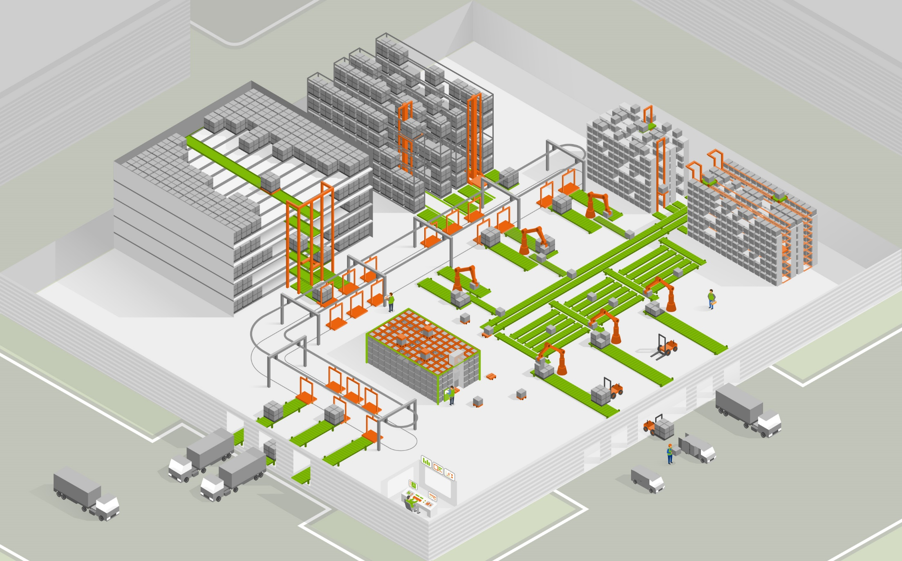
Pallet warehouse
+ stacker crane
Storage for crates
+ stacker crane
Pallet multideep + shuttle
Depalletization
Storage for crates
+ shuttle
Conveyors
Sorting systems
Monorail
Palletizing
Autostore
Automated unloading and loading
AMR
Data digitization
PYRONOVA Group
APRIL 2024
1

Slide 4


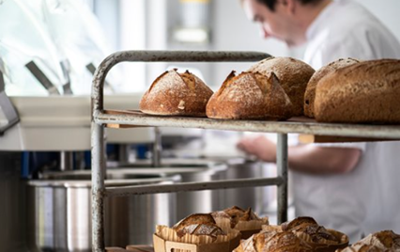
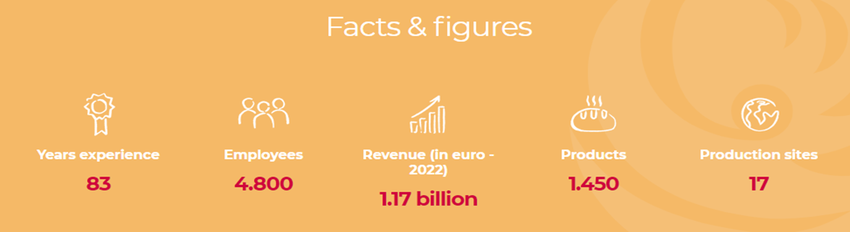
La Lorraine Bakery Group (LLBG) is a 100% Belgian family-owned company with more than 80 years of experience in the milling and bakery sector. Every day, more than 4,800 enthusiastic employees create and sell high-quality bakery products worldwide to consumers, retailers and the foodservice sector in more than 35 countries
PYRONOVA Group
APRIL 2024
2

Slide 5


222dfbhvbla220222
THE RISK OF FIRE
Possible fire causes or fire sources are:
• Sparks from overloaded electronic components
• Overheated / overloaded cables
• Conveyer belt drive motors
• Electrical storage and retrieval machinery
• Technical defects
• Cooling units
PYRONOVA Group
APRIL 2024
3

Slide 6
222dfbhvbla220222
FIRE IN A COLD STORE WAREHOUSE
What can happen:
• Fire spread even faster due to dry air and low temperature
• Impairs the function of conventional fire protection solutions
• Impossible to use conventional water-based extinguishing systems
• Antifreeze would contaminate and damage the stored food
PYRONOVA Group
APRIL 2024
4

Slide 7
222dfbhvbla220222
THE RISK ANALYSIS / CHALLENGE
  Find a certified and local accepted solution
  To protect the stored food from any damage
  Prevent staff from being injured
  Avoid process interruption
  Supply chain protection
FOR THESE KIND OF CHALLENGES,
WE DEVELOPED OXYGEN REDUCTION SYSTEM!
PYRONOVA Group
APRIL 2024
5

Slide 8
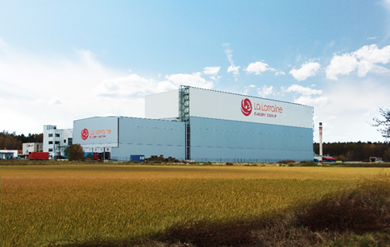

LA LORRAINE
222dfbhvbla220222
Automated cold storage (-25 ºC / -13 ºF)
Kladno (CZ) – 2013
  Bakery products and confectionery
  Storage volume ca. 166,000 m³ – 27,000 pallet slots – ca. 38 m high
  Fire protection solution consisting of:
    OxyReduct® active fire prevention
    Fire detection and alarm with TITANUS® aspirating smoke detectors
PYRONOVA Group
APRIL 2024
6
Notes:
Redundant design (n+1)
Local approval by the accredited certification body PAVUS (Prague.)
Nowy Dwór Mazowiecki (PL)
2 protected areas with ca. 314,000 m3

Slide 9
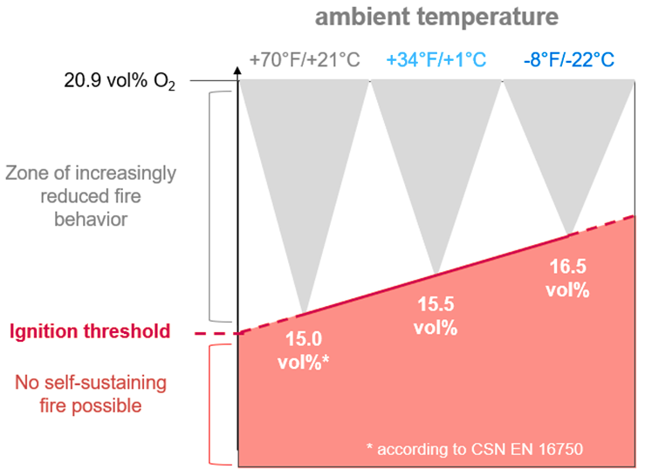

IGNITION THRESHOLD IN REFRIGERATED AREAS
222dfbhvbla220222
Example with corrugated cardboard:
The ignition risk is reduced by decreasing ambient temperature!
PYRONOVA Group
APRIL 2024
7

Slide 10

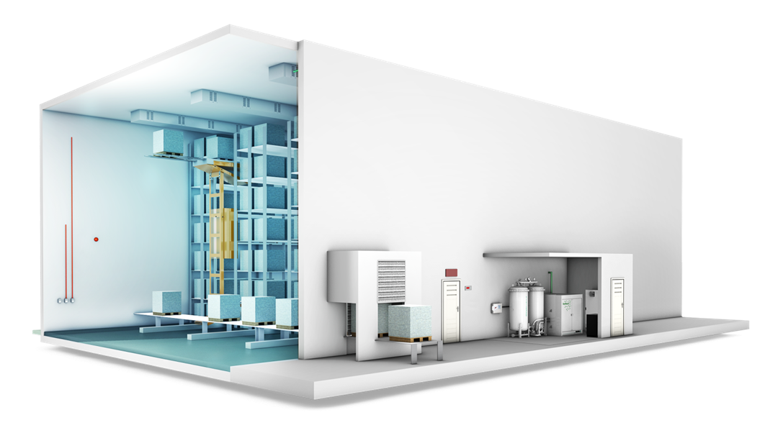
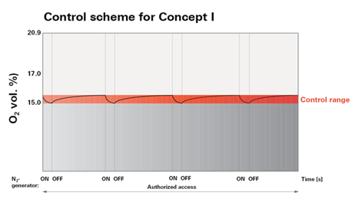
SYSTEM OVERVIEW
222dfbhvbla220222
Protected
area
OxyControl panel
OxySens
Airlock
OxyReduct module
PYRONOVA Group
APRIL 2024
8

Slide 11
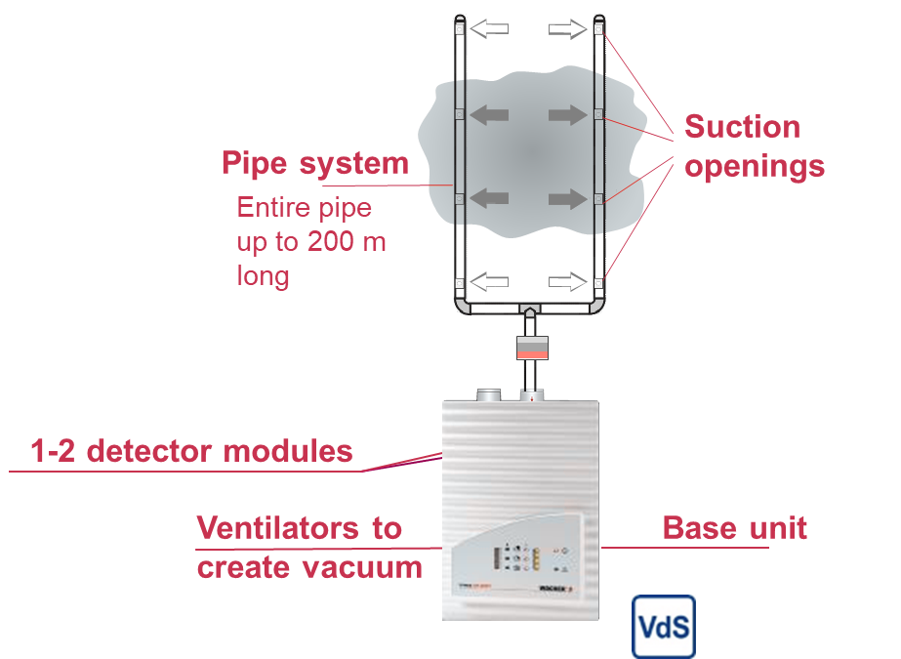
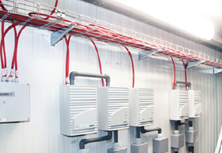
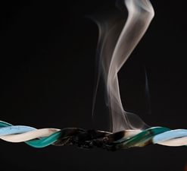
TITANUS® ASPIRATING SMOKE DETECTOR
Sensitivity Class A , EN54-20
222dfbhvbla220222
Active system –
continuous air sampling to detect smoke particles
Approved for -45°C !!!!
PYRONOVA Group
APRIL 2024
9

Slide 12
OXYREDUCT® INSTALLATION
in Kladno, CZ – 2013 / 2014
222dfbhvbla220222
Cold Store Warehouse
Net Volume in m³ 165.000
Temperature -22°C
Stored material Frozen Food
Goods inbound / outbound
per year 660.000
VPSA Nitrogen Generator 5 (n+1 system)
Oxygen Sensors 11
TITANUS Aspiration System
Class A / ABS pipe 22 / 5900 m
PYRONOVA Group
APRIL 2024
10

Slide 13
LA LORRAINE
222dfbhvbla220222
Automated cold storage (-25 ºC / -13 ºF)
Kladno (CZ) – 2023
  Bakery products and confectionery
  Storage volume ca. 183,000 m³ – 35,000 pallet slots – ca. 38 m high
  Fire protection solution consisting of:
    OxyReduct® active fire prevention
    Fire detection and alarm with TITANUS® aspirating smoke detectors
PYRONOVA Group
APRIL 2024
11
Notes:
Redundant design (n+1)
Local approval by the accredited certification body PAVUS (Prague.)
Nowy Dwór Mazowiecki (PL)
2 protected areas with ca. 314,000 m3

Slide 14
OXYREDUCT®INSTALLATION
in Kladno, CZ – 2023 / 2024
222dfbhvbla220222
Cold Store Warehouse
Net Volume in m³ 183.000
Temperature -22°C
Stored material Frozen Food
Goods inbound / outbound
per year 2.102.400
VPSA Nitrogen Generator 3 (n+1 system)
Oxygen Sensors 15
TITANUS Aspiration System
Class A / ABS pipe 28 / 7400 m
PYRONOVA Group
APRIL 2024
12

Slide 15
CONTACT US
PYRONOVA IS, s.r.o.
Phone number: +420 513 034 770
email: pyronova.cz@pyronova.com
Pavel Devečka
Phone number: +420 733 529 041
email: pavel.devecka@p﻿yronova.com
WAGNER Austria GmbH
Phone number: +43. 2262. 64262-0
email: office@wagner-austria.com
Gerald Koller
Phone number: +43 2262 64262 21
email: koller@wagner-austria.com
PYRONOVA Group
APRIL 2024
13

